Slide 1




Slide 2

BUSINESS ETIQUETTE- PLANNING, TYPES OF PLANNING, PROGRESS CHECK

Slide 3
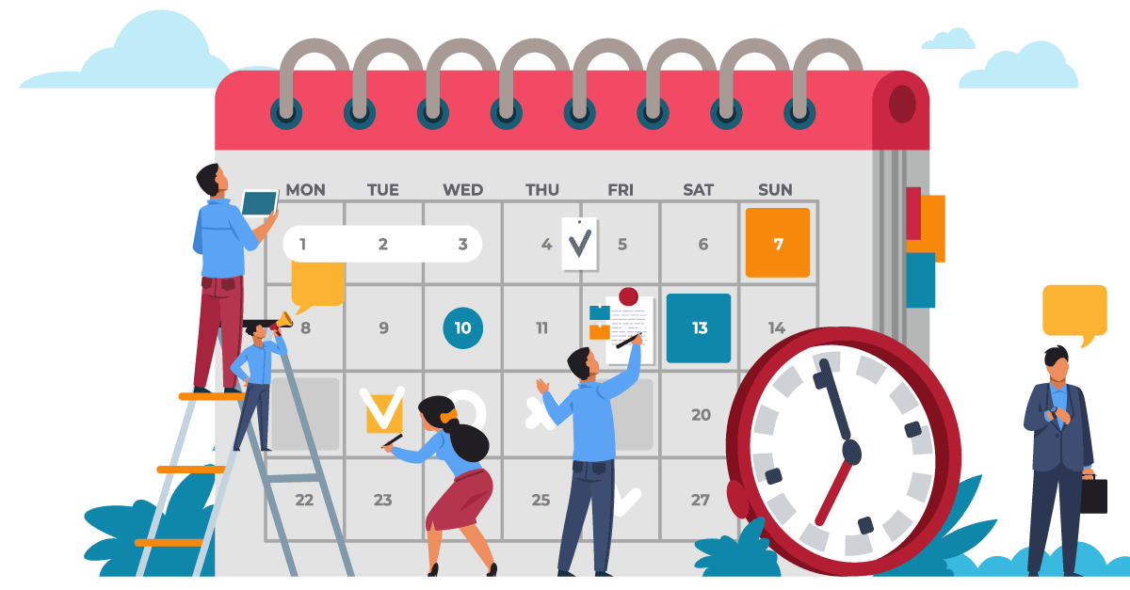
What is planning?
Notes:
Planning is the process of defining a company’s reason for existing, setting goals aimed at realizing full potential, and creating increasingly discrete tasks to meet those goals.
Each phase of planning is a subset of the prior, with strategic planning being the foremost
There are four phases of a proper organizational plan: strategic, tactical, operational, and contingency. Each phase of planning is a subset of the prior, with strategic planning being the foremost.

Slide 4

Importance of Planning
Notes:
1. Planning provides direction for an action or an objective
Planning provides direction to all the organization’s activities by clarifying the objectives and targets. If the objectives are laid down, all the business plans will be specifically directed towards the objectives. Therefore, planning provides a clear-cut direction for all the departments and individuals working in the enterprise.
2. Planning reduces the risk of uncertainty
The process of planning involves forecasting or anticipating future events. This helps to reduce uncertainties in the business. It is also noted that these uncertainties are caused by the changes in technology, taste and fashion, and other business conditions. Sufficient provisions can be made in the plans to meet these uncertainties.
3. Planning reduces overlapping and wasteful activities
Effective planning lays down various courses of action that are useful in accomplishing objectives. The chances of wasteful overlapping and activities are reduced to a great extent.
4. Planning promotes innovation and creativity
Planning is the thinking function of management. It promotes innovative and creative thinking. Many new ideas come to the mind of a manager when he is planning.
Planning establishes standards for controlling
managerial control involves keeping activities on the right path by restricting deviations from the plans or standards. It is through the process of planning that the management establishes the standards of performance. These serve as the benchmark for the appraisal of actual performance. In other words, planning and controlling are like the inseparable twins of management. Planning facilities controlling.

Slide 5
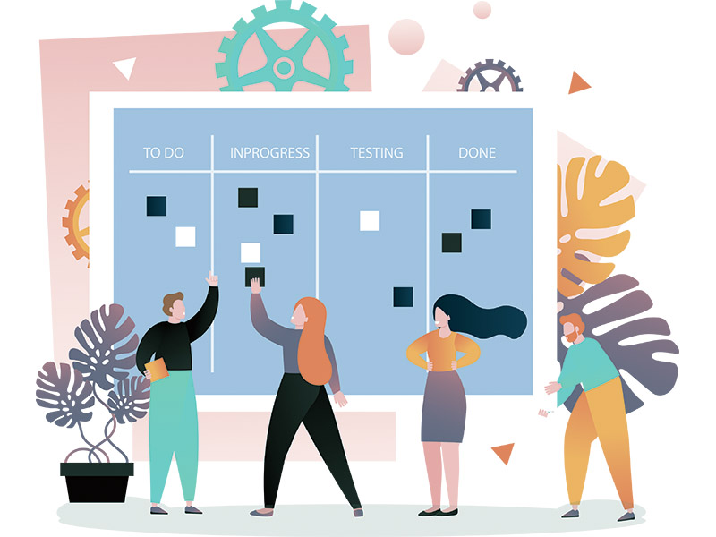
Types of Planning

Slide 6

Operational Planning
Notes:
Operational planning identifies the specific procedures and actions required at lower levels in the organization. If Harley- Davidson wants to revamp an assembly line to produce more sports bikes, operational plans would have to be drawn. In practice, the distinction between tactical planning and operational planning is not clear-cut. However, both tactical plans and operational plans must support the strategic plan such as revamping manufacturing and marketing to capture a larger group of young cyclists..
• It is short term
• It is more detailed because it is involves with day to day operations of the organization.
• Done at lower level of management
• Define what needs to be done in specific areas to implement strategic plans.
– Production plans
– Financial plans
– Facilities plans
– Marketing plans
– Human resource plans

Slide 7

Strategic Planning
Notes:
Strategic planning establishes master plans that shape the destiny of the firm. An example of strategic planning is when the executive team at Harley-Davidson Inc. planned how to deal with the demographic shift of their customer base becoming much older.
Strategic plans set broad, comprehensive, and longer-term action directions for the entire organization.
• It is the process of deciding on Long-term objectives of the organization.
• It encompasses all the functional areas of business
• It decides major goals and policies of allocation of resources to achieve these goals.
• Done at higher levels of management
• Less detailed because it is not involved with the day to day operations of the organization

Slide 8

Tactical Planning
Notes:
Tactical planning translates strategic plans into specific goals and plans that are most relevant to a particular organizational unit. The tactical plans also provide details of how the company or business unit will compete within its chosen business area. Middle level managers have the primary responsibility for formulating and executing tactical plans. These plans are based on marketplace realities when developed for a business. Conditions can change rapidly in competitive fields such as a Korean company suddenly developing a substantially lower price sports bike.
It involves conversion of detailed and specific plans into detailed and specification plans.
It is the blue print for current action and it supports the strategic plans.
It is Mid-term term
It is more detailed because it involves with day to day operations of the organization.
It is done at middle level of management

Slide 9

Contingency Planning
Notes:
Contingency plans wait in the wings in case of a crisis or unforeseen event. Contingency plans cover a range of possible scenarios and appropriate responses for issues varying from personnel planning to advanced preparation for outside occurrences that could negatively impact the business. Companies may have contingency plans for things like how to respond to a natural disaster, malfunctioning software, or the sudden departure of a C-level executive.

Slide 10

Steps of Planning
Notes:
The process of planning involves seven steps. The steps are as follows –
1. Setting objectives
The first step in the planning process is the establishment of objectives. Specific objectives have to be laid down, which can be achieved with the help of policies, procedures, rules, budgets, programs, and strategies. Objectives provide the nucleus to the planning process. They help the employees in understanding what is expected of them.
2. Developing premises
Planning premises are the assumptions about the likely shape of events in the future. They serve as the basis of planning. To make effective plans, the planning premises must be based on systematic forecasting. Assessment of future demand, the taste of customers, competition in the market, etc. can be made with forecasting.
3. Identifying alternative courses of action
Search for alternative plans or course of action is an important step in learning. Without resorting to a search for alternatives, a planner is likely to be guided by his limited imagination. Generally, there are several alternatives to solve any problem. The manager should try to screen out the most unviable alternatives to have a small number of alternatives for the final selection.
4. Evaluating alternatives
The alternatives generated at the previous stage are evaluated in the light of objectives, costs involved, availability of capital, materials, personnel, etc. The positive and negative aspects of each alternative course of action should be evaluated based on their feasibility and consequences.
5. Selecting the best alternative
This step involves decision-making. It involves quantitative analysis and judgment and experience of the manager. The alternative to be selected must be the most feasible and profitable and should have the least negative consequences. Sometimes, a combination of alternatives may be selected instead of one alternative.
6. Implementation of the plan
After choosing a particular plan, it is put into action by taking the necessary steps. Immaculate implementation of a plan revolves around the courses of action that strategic planning incorporates, and hence chances of getting favorable outcomes to get optimized. All in all, the implementation of a plan decides how effective strategic planning was in being operational planning.
7. Follow up action and review
After the plan has been implemented, it is necessary to monitor it to ensure various activities are performed as per schedule and objectives are achieved. Strategic planning, as well as operational planning, are only successful if they are executed in a result-driven manner. Follow-up and review methods help leaders and decision-makers to check the effectiveness of strategic and operational planning.

Slide 11

Features of Effective Planning

Slide 12

Planning focuses on achieving objectives
Notes:
Planning specifies the objectives to attain and lays down the necessary activities to achieve them.

Slide 13

Planning is the management’s primary function
Notes:
Planning logically proceeds with the performance of all the other managerial activities. It helps in an efficient organization. It assists in manpower planning and designing employment and training programs for the employees. Planning lays down the benchmark of performance for the employees with the help of which the manager can control the employees’ activities.

Slide 14

Planning is pervasive
Notes:
Planning is the basic function of managers at all levels. It is performed by the top-level management, middle-level, as well as lower-level management. However, the nature and the scope of planning vary in each level of management.

Slide 15
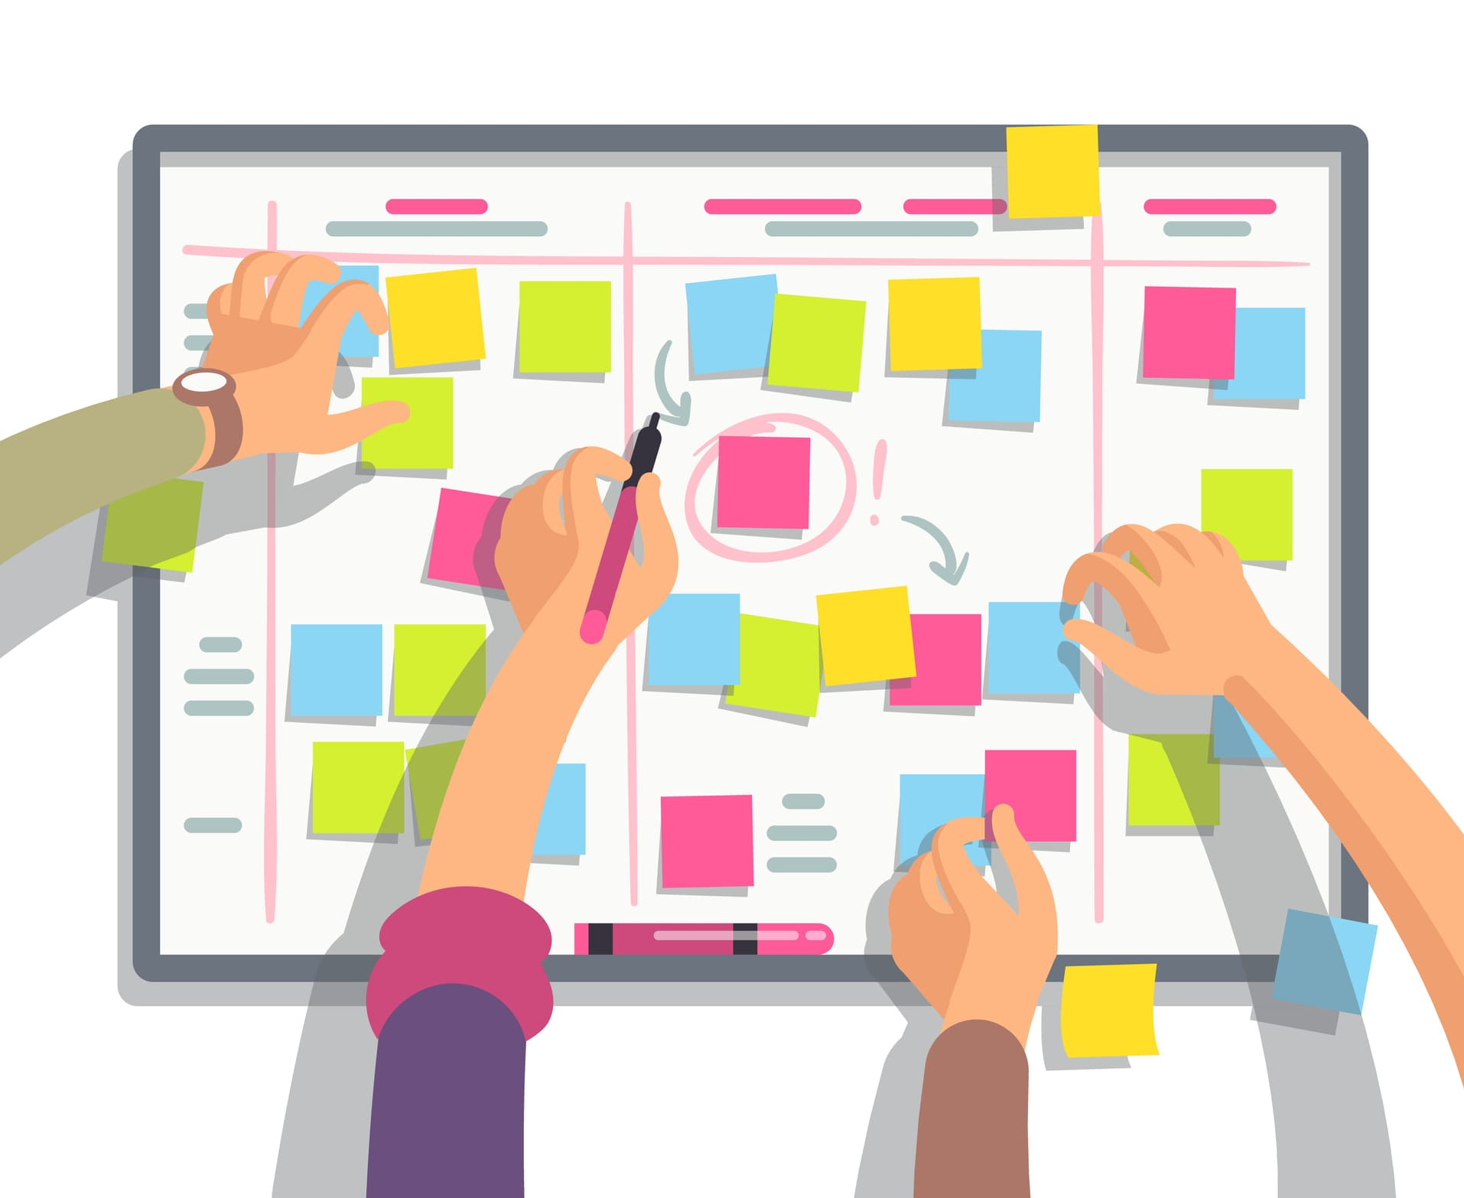
Planning is a continuous process
Notes:
Every manager is engaged in planning continuously. The old plans have to be revised, and the new ones are supposed to be introduced depending upon the situation’s needs. Thus, planning is a continuous process of making new plans and modifying existing plans to ensure that it is achieved.

Slide 16

Planning is futuristic
Notes:
Planning is a forward-looking process. It is carried out to achieve some objectives in the future. It involves forecasting future events like customers’ demands, competitions, government policies, etc.

Slide 17

Planning involves decision-making
Notes:
Planning involves searching for alternatives and selecting the best alternative to achieve specified objectives. Therefore, decision-making is an integral part of the planning process.

Slide 18

How to monitor progress
Notes:
1. Plan out your project
The first step to monitoring the progress of a project is creating an outline or plan for the project. You can collaborate with your project's team members to create a plan that works for everyone. In your project plan, you can include the project's scope and important elements like resources, tasks and deadlines. Additionally, you can create a timeline for all of the project's tasks with deadlines. You can also include the names of which team member is assigned to each task to help keep everyone on the team aware of their responsibilities.
In your plan, be sure to include your project's objectives and key performance indicators that you can use to measure its progress. You can also use project planning software or templates to create an overview of your project. Many project managers plan out projects by creating Gantt charts, which can illustrate a project's main tasks, timeframes and other important information in a bar chart format. You can choose the type of project plan that best fits your project and your team members.
2. Set clear goals for your project
Another important step in monitoring progress is setting goals so that each team member knows what they're working towards. You can use the SMART method to create clear goals for your project. SMART goals are:
Specific
Measurable
Attainable
Relevant
Time-based
Using the smart method can help you to create detailed, quantifiable goals that your team members can clearly understand. Additionally, setting deadlines for project tasks and objectives can help keep the project on schedule. Once you have set your project goals, you can begin measuring your project's progress in relation to your goals and key performance indicators.
3. Create a steady check-in schedule
You can also create a schedule for regular progress check-ins. The frequency of your check-ins may vary for different projects. For example, a short-term project might require more than one check-in per week, but some long-term projects might only need check-ins on monthly intervals. It's important to create a check-in schedule that balances checking in enough to keep your project on track while giving your team the freedom to work without giving you constant reports.
Once you've determined the best check-in schedule for your project, be sure to let your project team know when check-ins are scheduled to take place. During each check-in, compare your team members' progress to your key performance indicators and record data on your project to track its progress. You can also use check-ins as an opportunity to communicate with your project team and help them address any challenges they are facing, which can help make your project successful.
4. Record and analyze data
After each progress check-in, you can analyze data to help you gauge the overall progress of the project. There are many ways that you can gather data, including organizing meetings where team members can report their progress or creating a process for team members to prepare progress reports. You can choose a data collection process that is the most efficient for your team.
After you gather data, you can choose a method for recording it, including inputting key information into databases, spreadsheets or other project management tools. Then, you can analyze your data to determine how much progress you've made on your project and find areas that need improvement.
5. Make changes to your goals if necessary
Based on your progress monitoring, you can reevaluate your project's goals and decide if you want to adjust them or change your plan for achieving them. For example, you might decide to extend a deadline if you notice that your team is struggling to keep up with a certain task or if an important step in the project has been delayed. Additionally, if your data shows that your team is ahead of schedule, you could also change your goals to reflect this, allowing your team to complete the project sooner.

Slide 19

https://learn.codemithra.com

Slide 20




THANK YOU
+91 78150 95095
codemithra@ethnus.com
www.codemithra.com

